Slide 1

“Hi! My name is Sir Maina,an IT Specialist by proffession.
I was a campus student who was worried about securing a job after campus and time was running out
I was Not happy With my lack of results and I was desperately looking for a way to make something of my life.
In March 2023, was introduced to the CONNECTED ECONOMY and it has changed my life. Instead of being afraid of the future, now I’m excited about it."

Slide 2
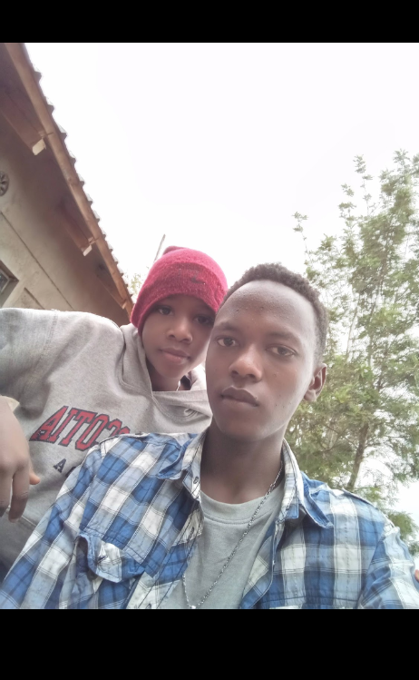
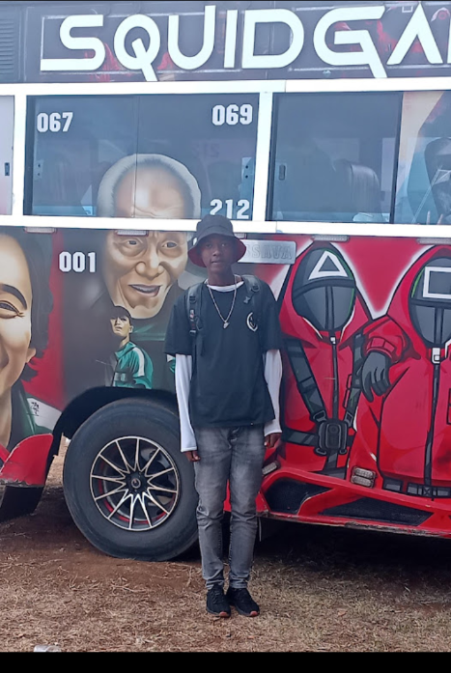
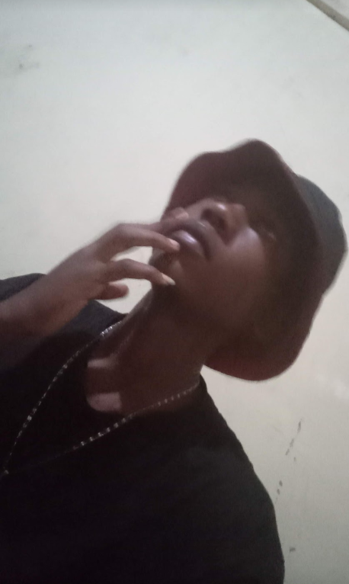

Slide 3
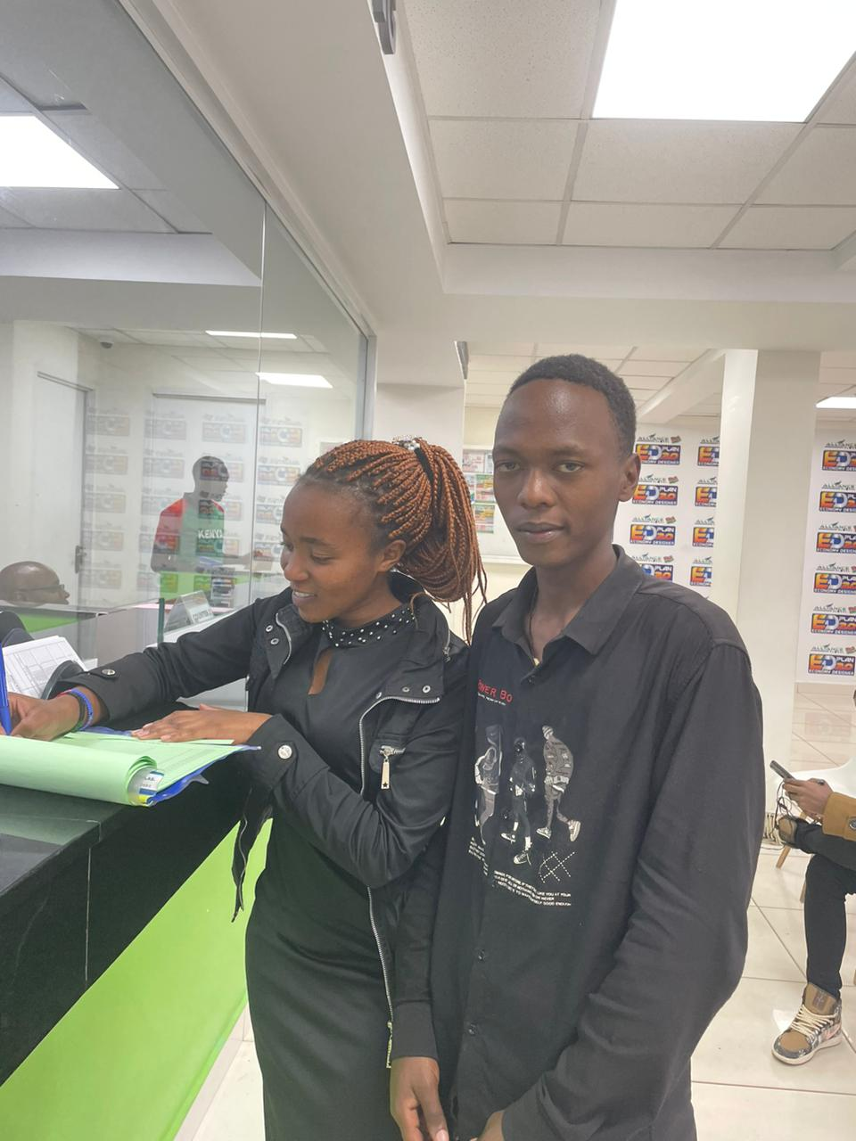
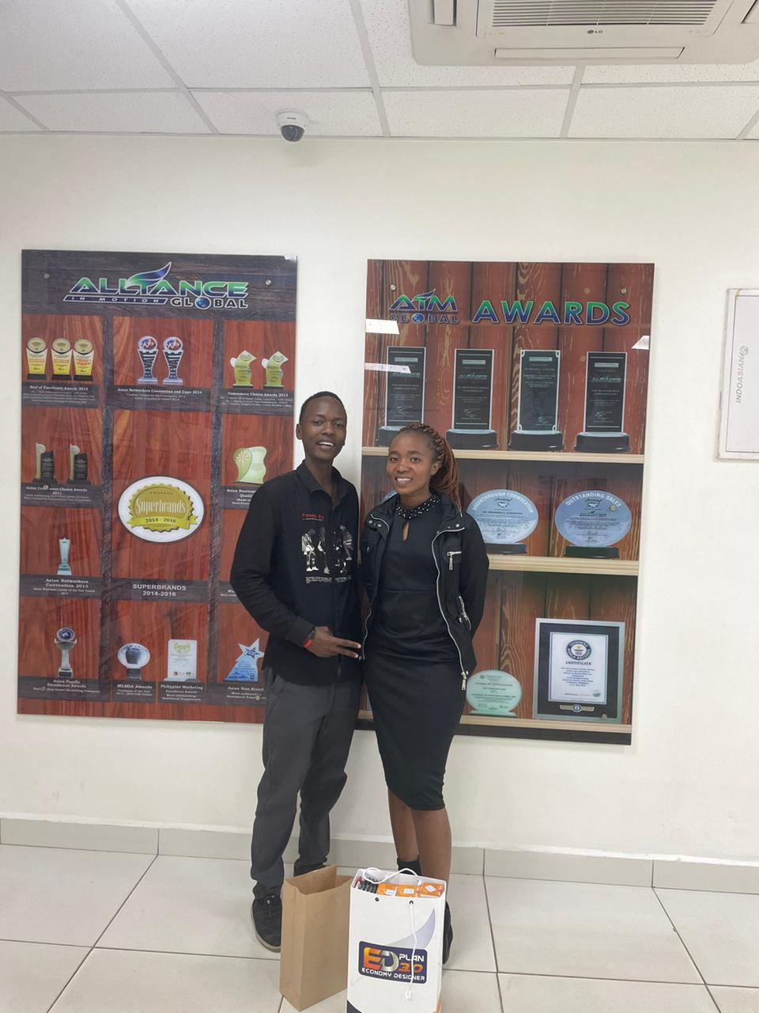
First day in the business
MY SECOND DAY IN BUSINESS

Slide 4
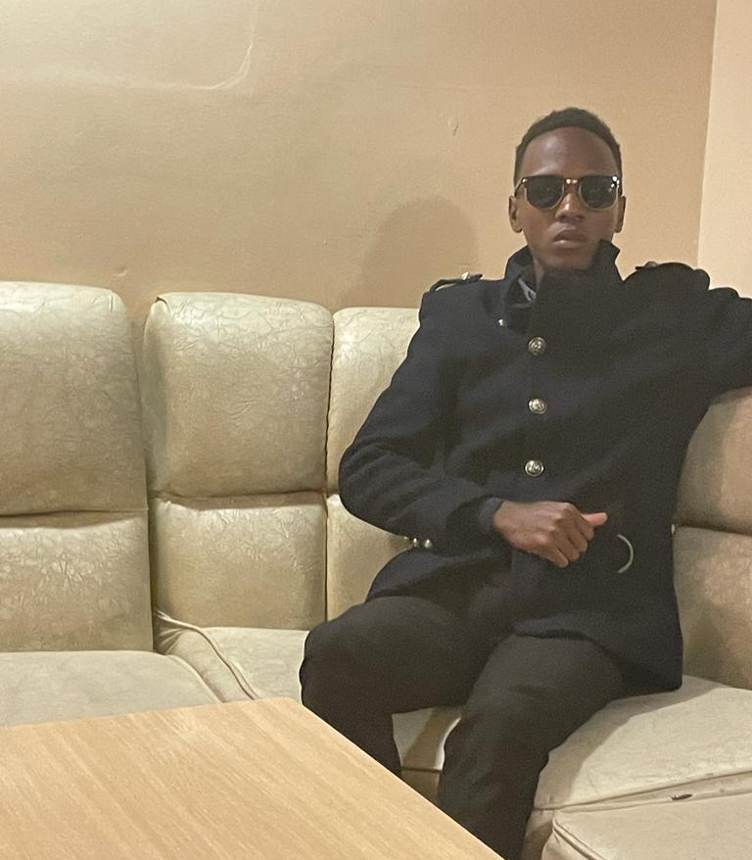
SIR. MAINA
I I'M A G LEADER AND SILVER
EXECUTIVE PRIME
I I'M THE FOUNDER OF PHOENIX FOUNDATION
I CREATE ELITE AND LASTING LEADERS.
IG: @Sir_maina_ah

Slide 5
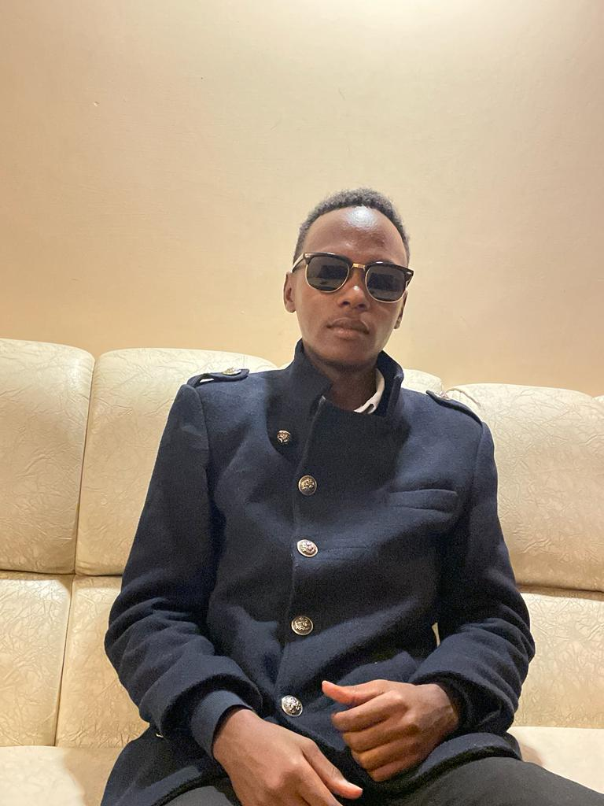
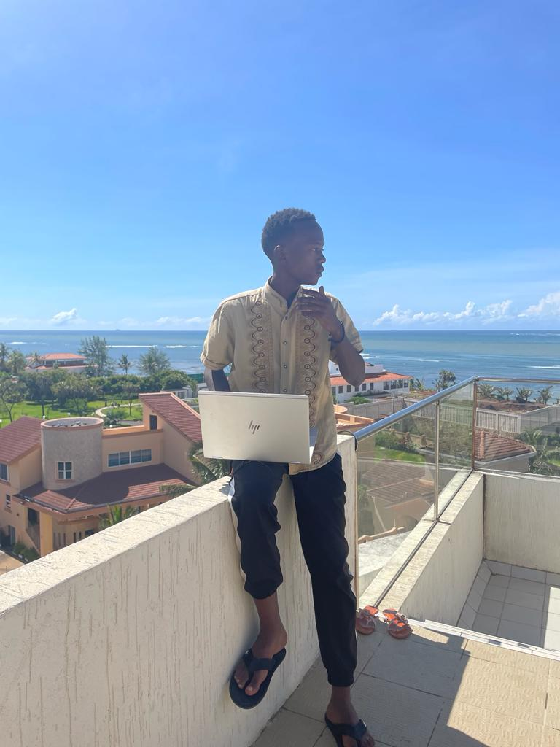
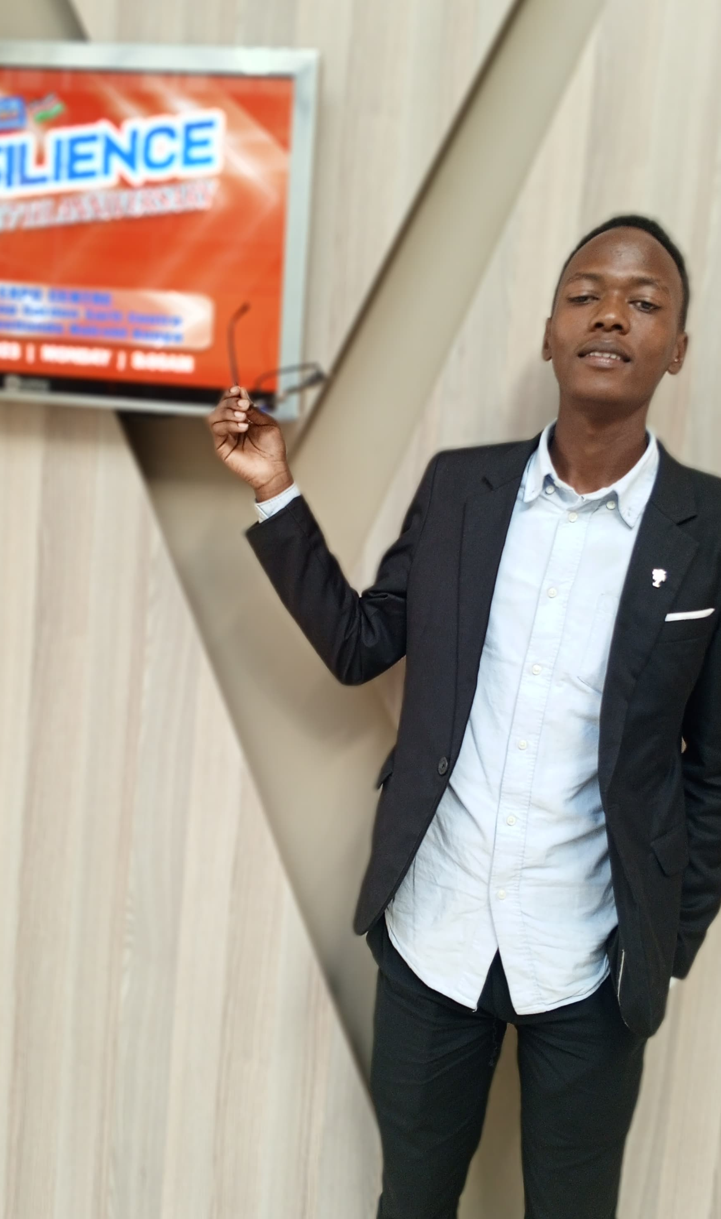
ME NOW

Slide 6
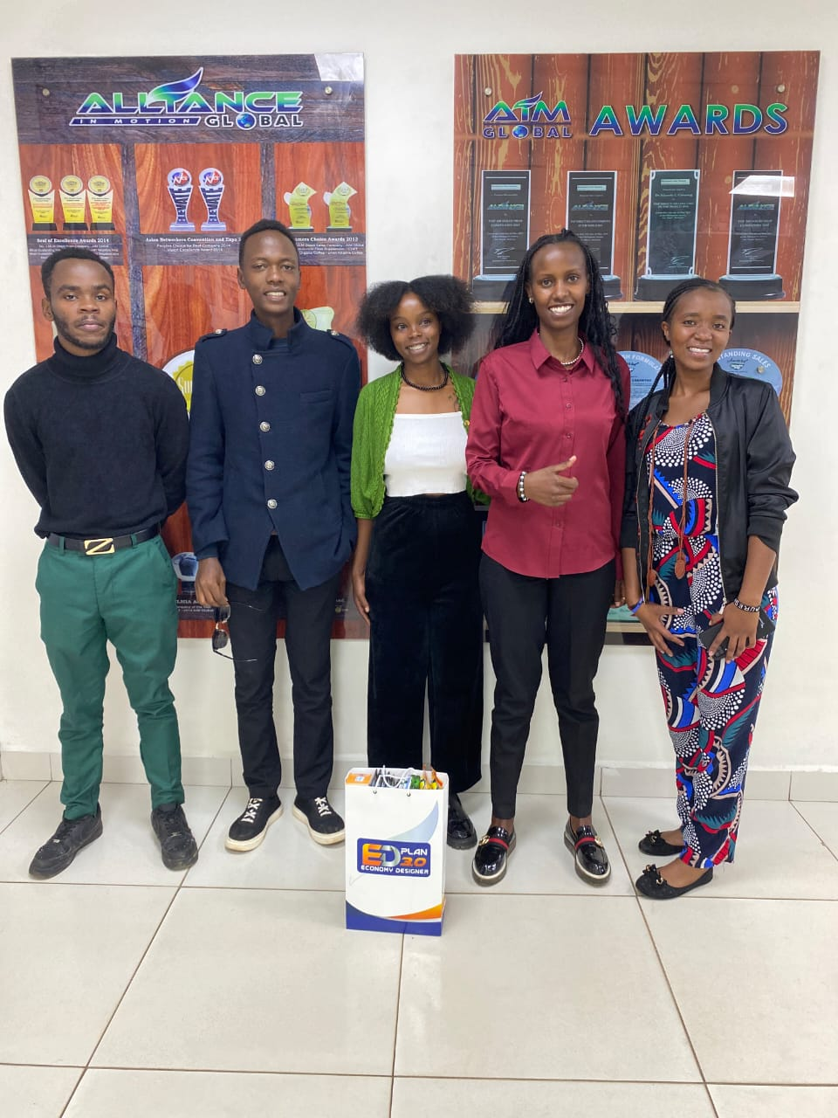
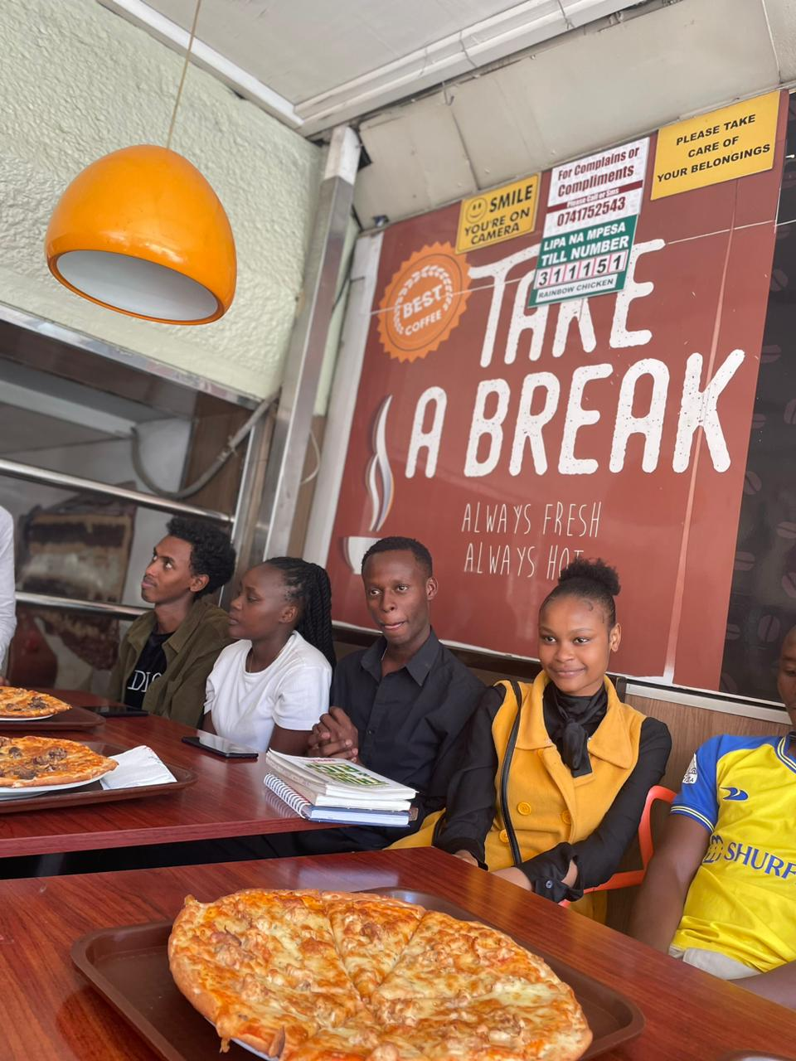
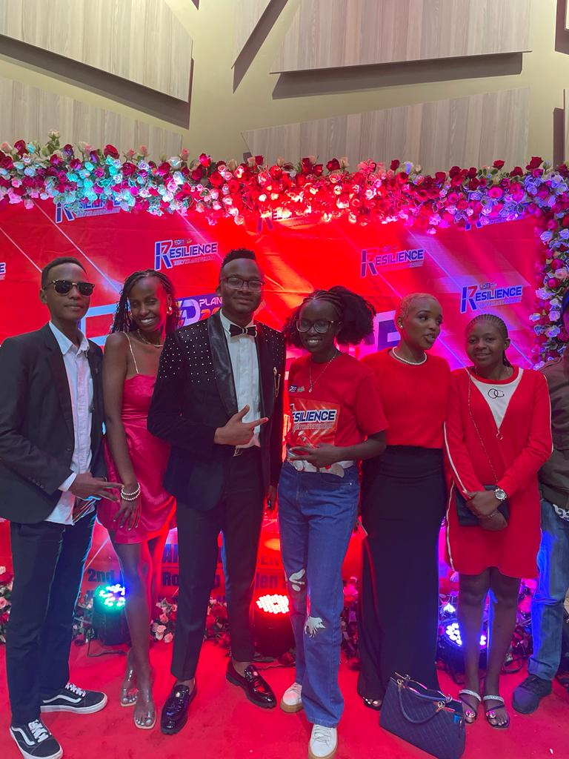
Me now

Slide 7
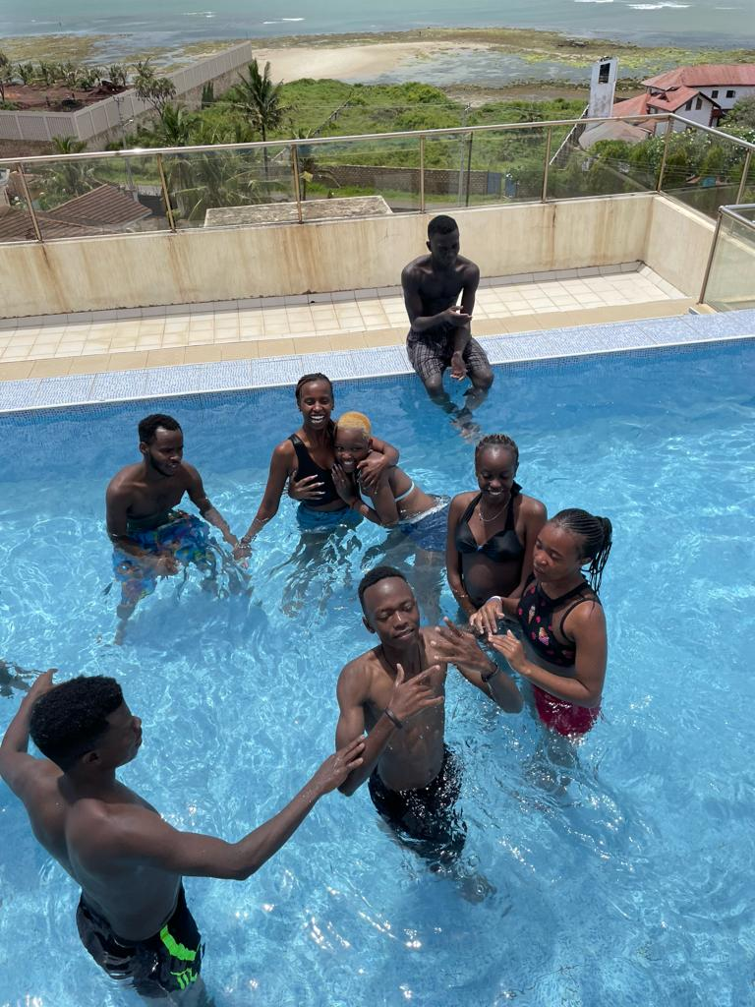
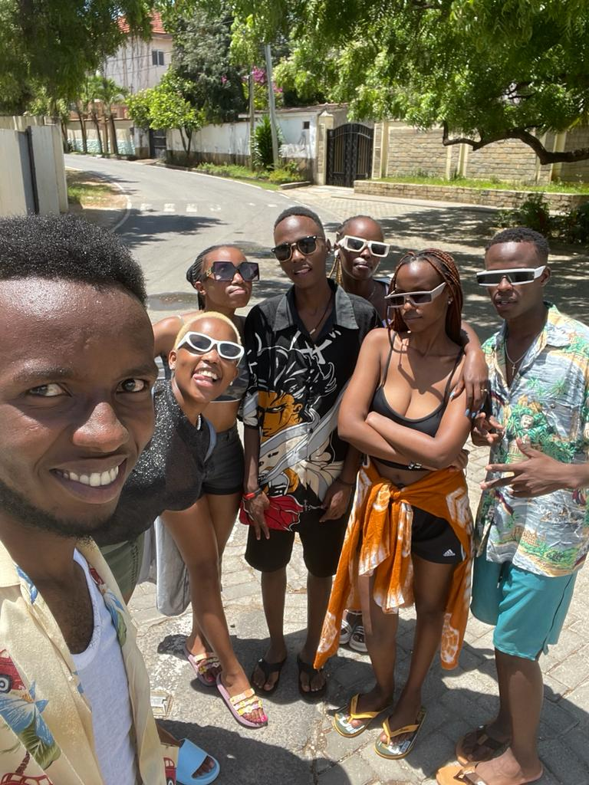
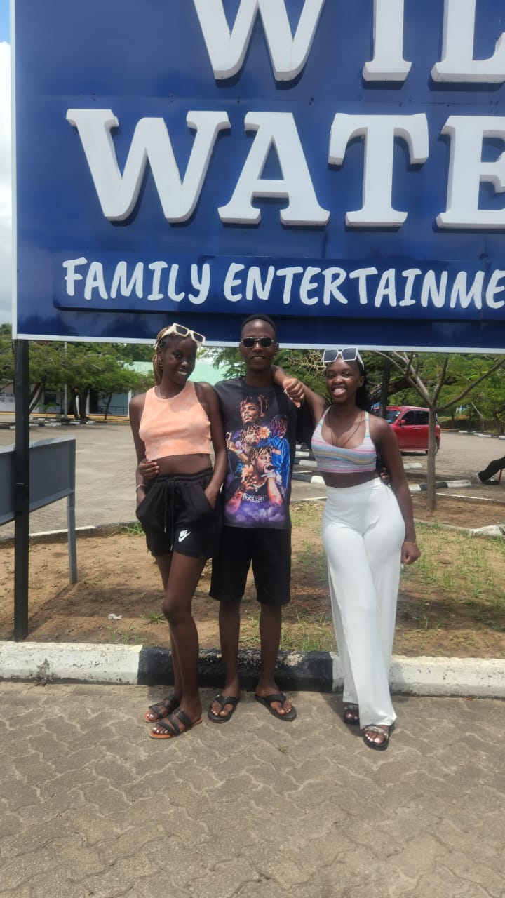
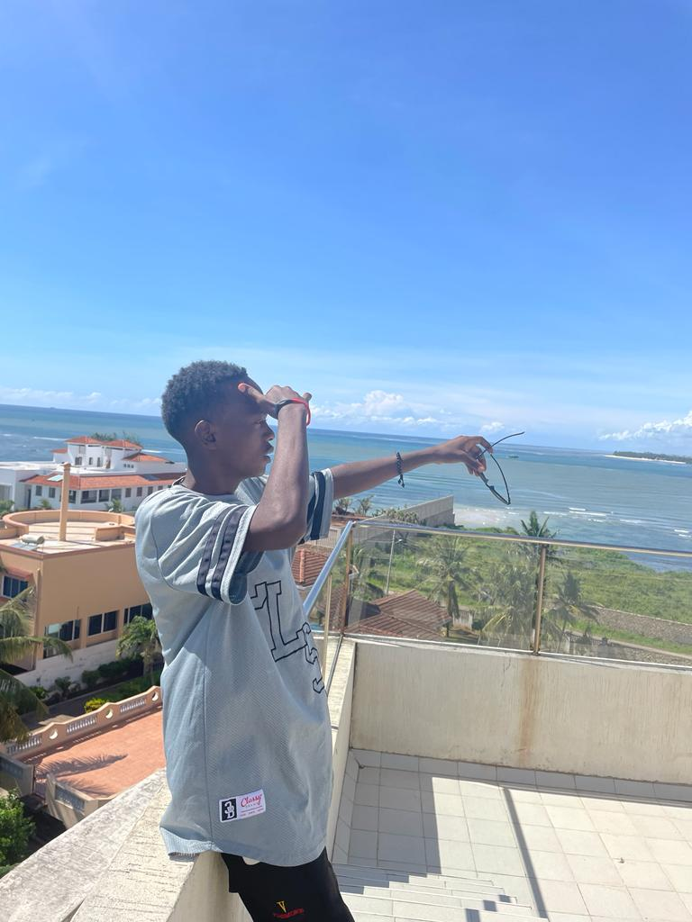
BETA VACATION

Slide 8
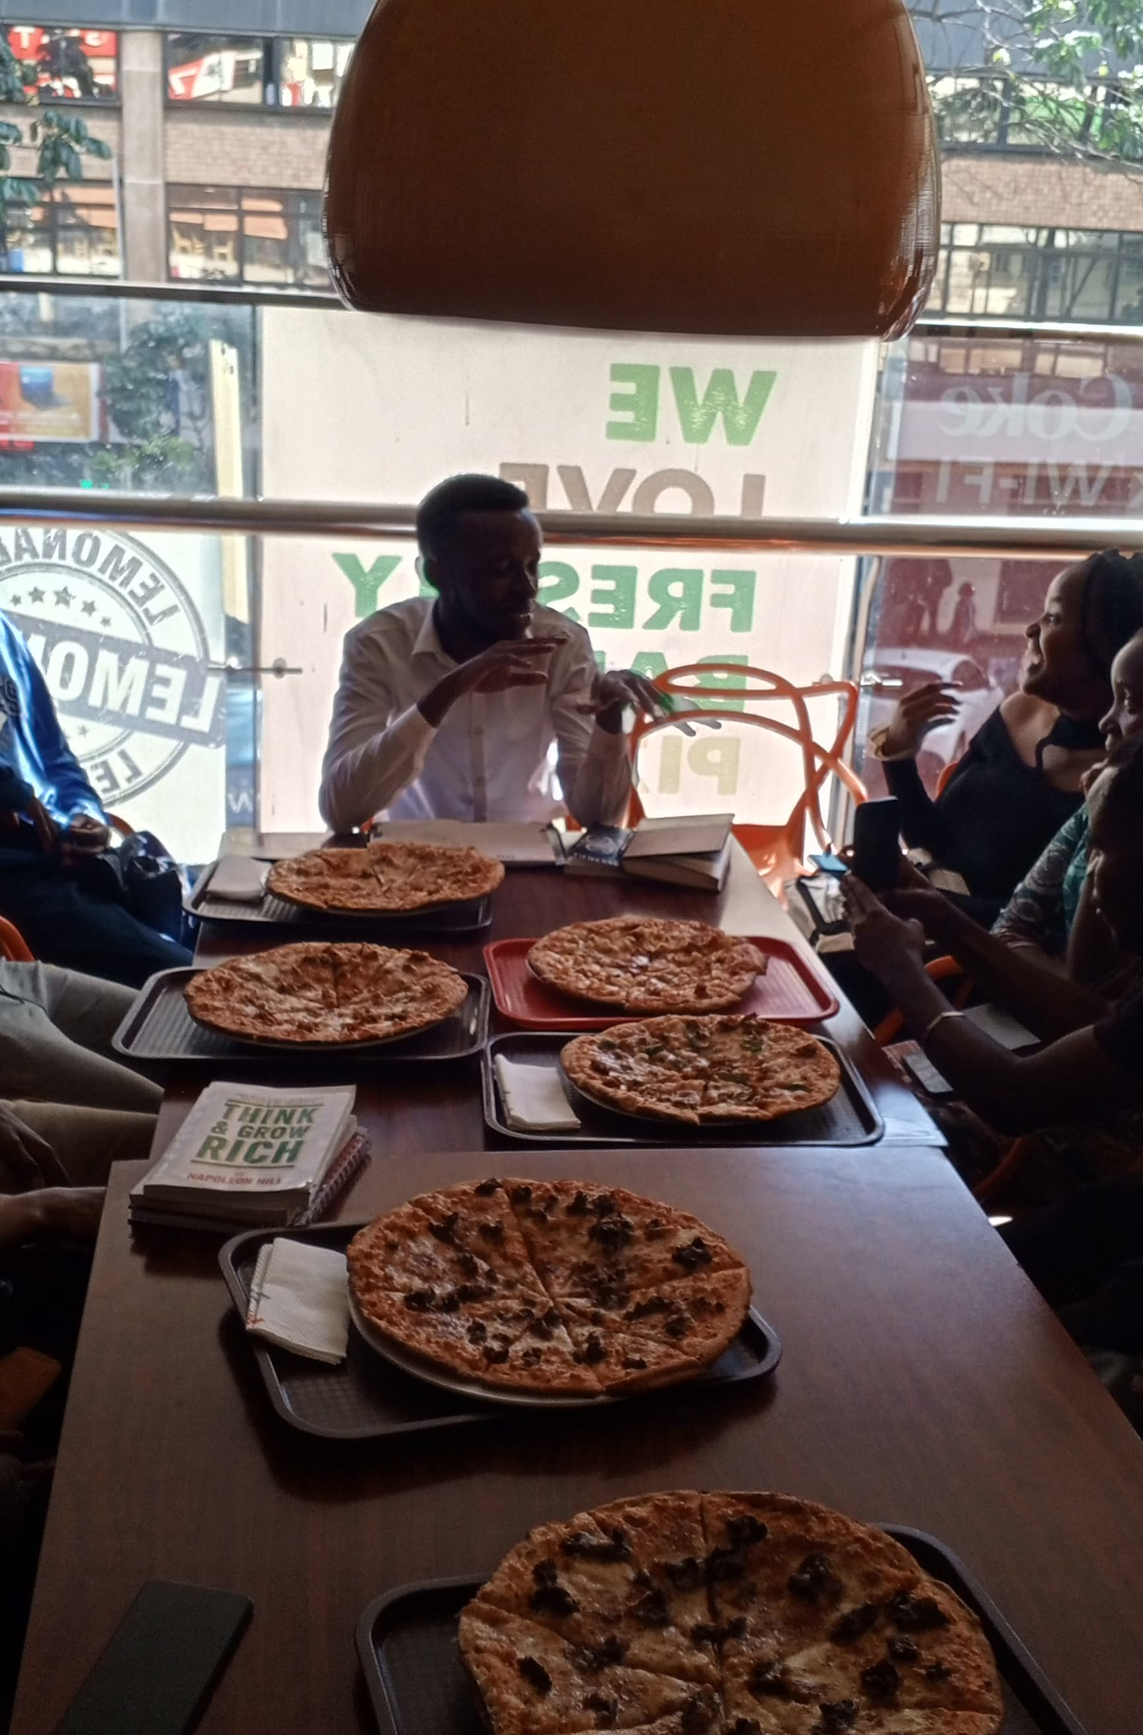
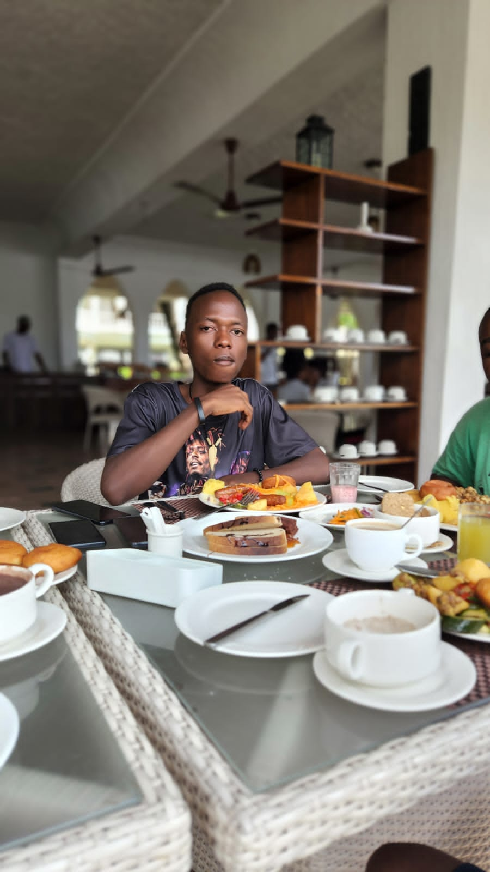
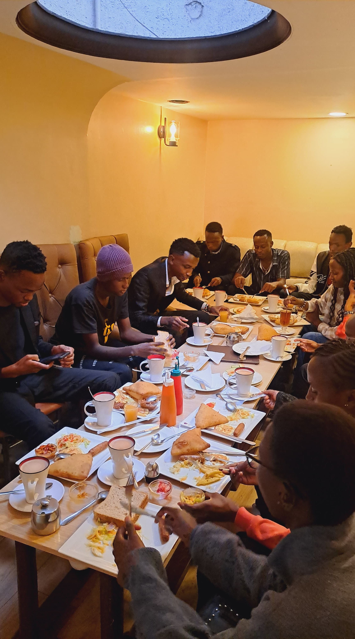

Slide 9
Our JOURNEY
BETA OWN YOUR LIFE PROJECT LAUNCHED in the year 2020.
Born by experienced MLM rock stars from ED PLAN 3.0
Having the B. O. Ds who have over 50 years experience in the connected economy.
A GROUP OF LIKE-MINDED INDIVIDUALS WHOSE FINANCIAL STATUS WERE ON THEIR KNEES.
WE HAD A LOT OF CHALLENGES THAT NEEDED SOLUTIONS – ATTRITION, NEGATIVE ENERGY, COMPETITION WITHIN AND WITHOUT THE COMPANY, SCAMS ETC.

Slide 10
MISSION
TO IMPACT 1,000,000 LIVES POSITIVELY THROUGH OUR SYSTEMS BY 2025.

Slide 11

BASIC START UP PACKAGE

Slide 12
Pays YOU in six (6) different ways, namely:
DIRECT CONNECTORS BONUS
MATCHING BONUS
UNILEVEL BONUS
STAIR STEPS BONUS
UNI PAY PLAN BONUS
RETAIL BONUS

Slide 13
1
Direct Connector’s Bonus
KES 6,000

Slide 14


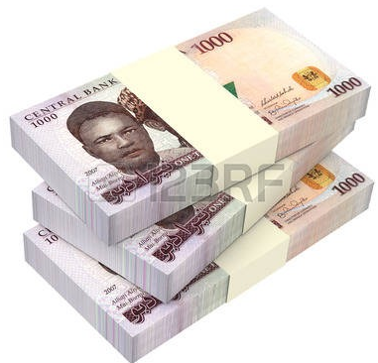
Direct Connector Bonus
FOR ANYONE YOU CONNECT
EARN
KSH6,000
=
600,000
100
YOU
Notes:
YOU CAN SPONSOR AS MANY AS YOU WANT

Slide 15
2
Matching Bonus(MB)
KES 4,800

Slide 16

YOU
LEFT
GROUP SALES
RIGHT
GROUP SALES
6,000
6,000
4,800
Direct Bonus - 6,000
Direct Bonus - 6,000
Match Sales Bonus - 4,800
Total - 16,800

Slide 17




SPILLOVER SUPPORT SYSTEM
ALICE
SPILL OVER
6,000
6,000
LEFT
RIGHT
6,000
YOU
CARO
KEN
4,800
OTHER SYSTEMS

Slide 18
RESIDUAL EARNINGS
FROM
Matching Bonus

Slide 19
2. MATCHING/PAIRING SALES BONUS
LEFT
YOU
RIGHT
6,000/=
6,000/=
A
4,800/=
B
6,000/=
6,000/=
6,000/=
6,000/=
DRB 12,000/=
C
4,800/=
D
E
4,800/=
F
16,800/=
16,800/=
MSB 4,800/=
4,800/=
4,800/=
TOTAL 16,800/=
4,800/=
4,800/=
4,800/=
4,800/=
4,800/=
4,800/=
4,800/=
4,800/=
4,800/=
4,800/=
4,800/=
UPTO INFINITY
4,800/=

Slide 20





ONE YEAR SCENARIO WITH ONE HAMPER
Match Pairing Bonus
3 Hampers
You
MAY 2023
2
4,800 KSh
4
9,600 KSh
YOU
JUNE
JULY
8
19,200 KSh
YOU
=
YOU
AUG.
16
38,400 KSh
KSH. 58,968,000
SEPT.
32
76,800 KSh
OCT
64
153,600 KSh
7 Hampers
NOV
128
307,200 KSh
DEC
256
614,400 KSh
JAN
512
1,228,800 KSh
FEB
1,024
2,457,600 KSh
YOU
MAR
2,048
4,915,200 KSh
YOU
YOU
APRIL
4,096
9,830,400 KSh
YOU
YOU
YOU
YOU
12 Mths
8,192 pple
19,656,000 KSH
=
KSH.137,592,000

Slide 21
CHOOSE YOUR PREFERED STARTUP PLAN CAREFULLY
ENTRIVERSE: 1 ACCOUNT
COST: 26,888, DAILY INCOME POTENTIAL : 96,000
NEOVERSE:3 ACCOUNTS
COST: 39,000, DAILY INCOME POTENTIAL :288,000
TECHNOVERSE: 7 ACOUNTS
COST 115,000, DAILY INCOME POTENTIAL 672,000
DIGIVERSE: 15 ACCOUNTS
COST 236,000, DAILY INCOME POTENTIAL 1,440,000
MEGAVERSE: 31 ACCOUNTS
COST: 436,000, DAILY INCOME POTENTIAL 2,976,000

Slide 22
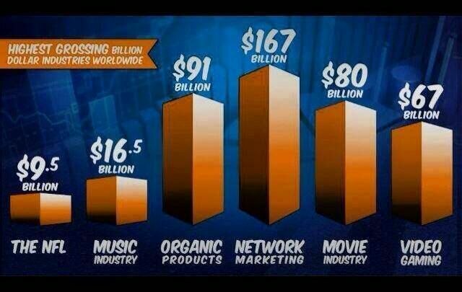

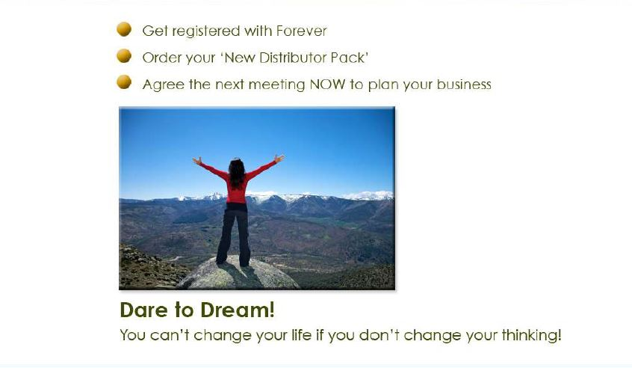


Slide 23

“I learned this, at least, by my experiment: that if one advances confidently in the direction of his dreams, and endeavors to live the life which he has imagined, he will meet with a success unexpected in common hours.- Henry Thoreau

Slide 24
